Slide 1
Mobile Database Systems
Vijay Kumar
Computer Sc. Telecommunications
University of Missouri-Kansas City
5100 Rockhill Road
Kansas City, MO 64110, USA
kumar@cstp.umkc.edu

Slide 2
Mobile Database Systems
Outline
  Fully Connected Information Space
  Personal Communication System (PCS)
  Mobile Database Systems (MDS)
  Transaction Management
  Data Caching
  Query Processing
  Data Classification
  Conclusion

Slide 3
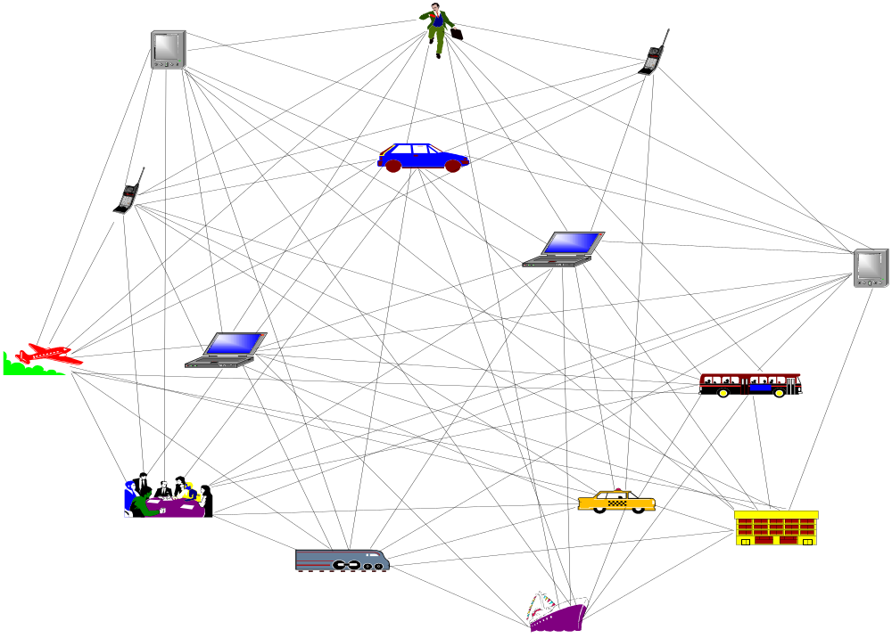
Mobile Database Systems
Fully connected information space

Slide 4
Mobile Database Systems
Fully connected information space
Each node of the information space has some communication capability.
Some node can process information.
Some node can communicate through voice channel.
Some node can do both

Slide 5
Mobile Database Systems
Fully connected information space
Can be created and maintained by integrating legacy database systems, and wired and wireless systems (PCS, Cellular system, and GSM)

Slide 6
Mobile Database Systems
What is a Mobile Database System (MDS)?
A system with the following structural and functional properties
    Distributed system with mobile connectivity
    Full database system capability
    Complete spatial mobility
    Built on PCS/GSM platform
    Wireless and wired communication capability

Slide 7
Mobile Database Systems
What is a mobile connectivity?
A mode in which a client or a server can establish communication with each other whenever needed. Intermittent connectivity is a special case of mobile connectivity.

Slide 8
Mobile Database Systems
What is intermittent connectivity?
A node in which only the client can establish communication whenever needed with the server but the server cannot do so.

Slide 9
Personal Communication System (PCS)
  Part 1
  Architecture
  Wireless communication
  Bandwidth limitations
  Frequency reuse

Slide 10
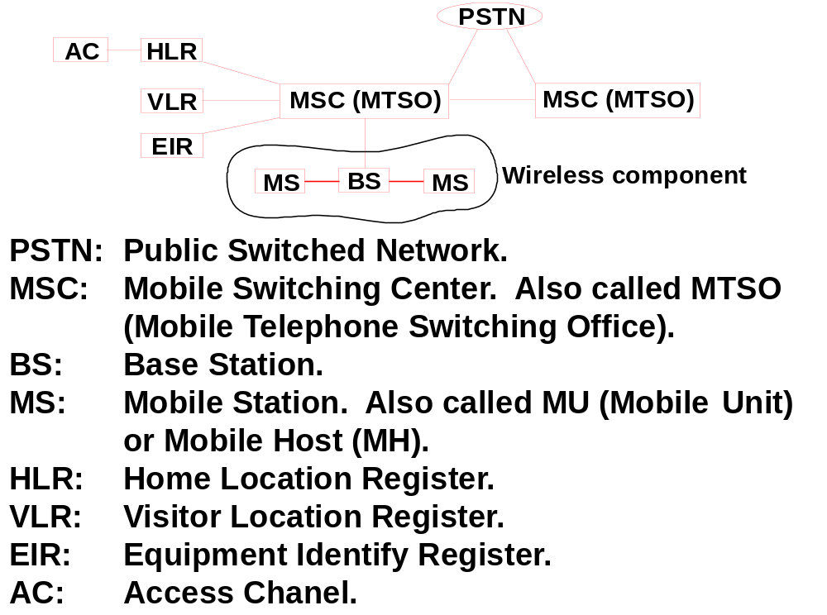
Personal Communication System (PCS)
A system where wired and wireless networks are integrated for establishing communication.

Slide 11
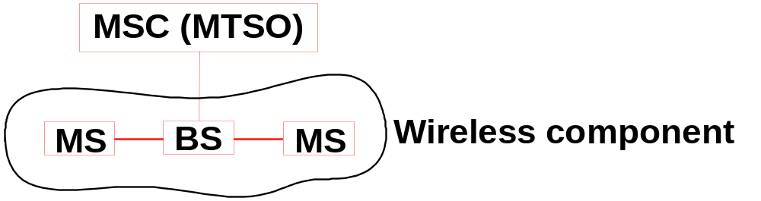
Personal Communication System (PCS)
Wireless Components
Base Station (BS): A switch, which serves as communication link between MU and the entire network
Mobile Units (MU): Also called Mobile Systems (MS) or Mobile Hosts (MH). A mobile component, which communicates with BS through a limited number of wireless channels.

Slide 12
Personal Communication System (PCS)
Wireless channels are limited
Item | Europe (MHz) | US (MHz) | Japan (MHz)
Mobile Phones | NMT: 453-457, 463-467 GSM: 890-915, 935-960, 1710-1785, 1805-1880 | AMPS, TDMA, CDMA 824-849, 869-894 GSM, TDMA, CDMA 1850-1910, 1930-1990 | PDC: 810-826 940-956, 1429-1465, 1477-1513.
Cordless Phones | CT1+: 885-887, 930-932 CT2: 864-868 DECT: 1880-1900 | PACS 1850-1910,1930-1990; PACS-UB: 1910-1930 | PHS 1895-1918; JCT: 254-380
NMT: Nordic Mobile Telephone
PDC: Pacific Digital Cellular
PACS: Personal Access Communications System
PHS: Personal Handyphone System
PACS-UB: PACS Unlicensed Band
JCT: Japanese Cordless Telephone
(Taken from Mobile Communications by Jochen Schiller)

Slide 13
Personal Communication System (PCS)
Limited channels must be utilized efficiently. It is done so by
  Frequency reuse
  The same radio frequency is used for communication by more than one cell sessions.
  Mobile cells
  To achieve frequency reuse, the entire wireless coverage area is divided into cells.

Slide 14
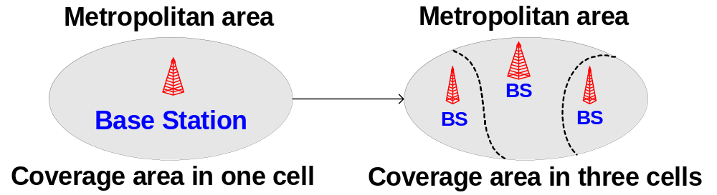
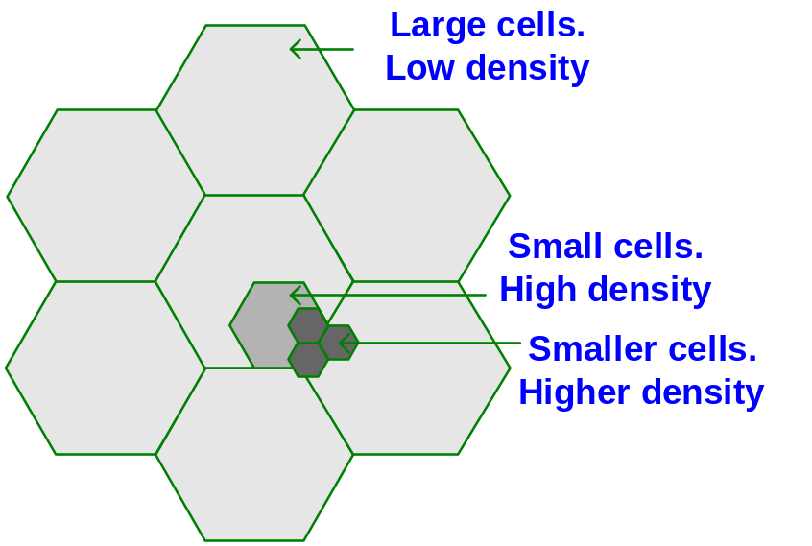
Personal Communication System (PCS)
Mobile cells

Slide 15
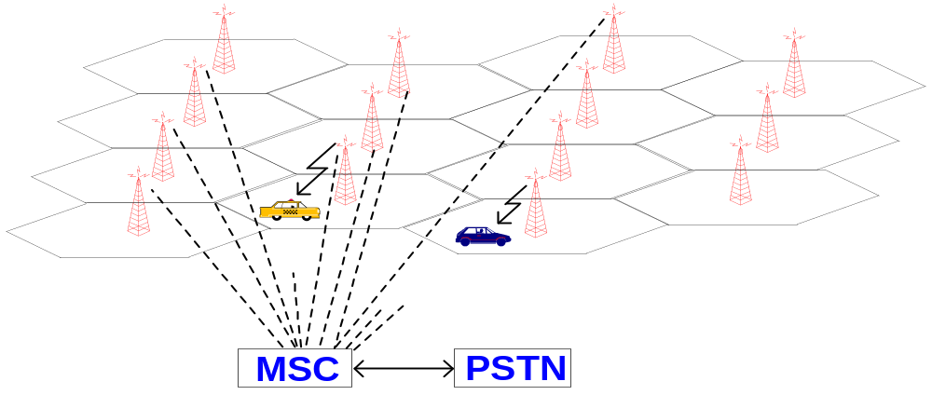
Personal Communication System (PCS)
Mobile cells
  The entire coverage area is a group of a number of cells. The size of cell depends upon the power of the base stations.

Slide 16
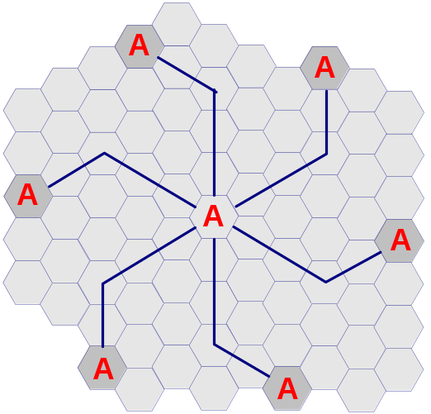
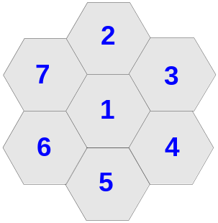
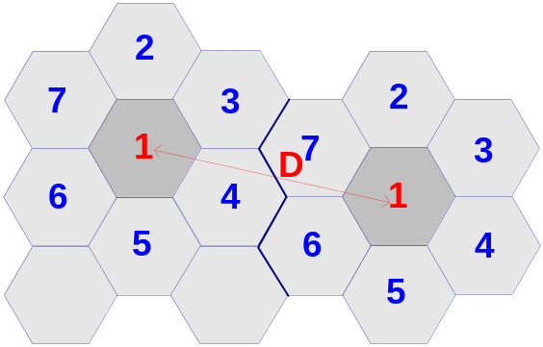
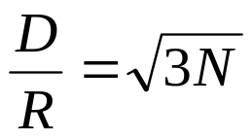
Personal Communication System (PCS)
Frequency reuse
D = distance between cells using the same frequency
R = cell radius
N = reuse pattern (the cluster size, which is 7).
Thus, for a 7-cell group with cell radius R = 3 miles, the frequency reuse distance D is 13.74 miles.

Slide 17
Personal Communication System (PCS)
Problems with cellular structure
  How to maintain continuous communication between two parties in the presence of mobility?
    Solution: Handoff
  How to maintain continuous communication between two parties in the presence of mobility?
    Solution: Roaming
How to locate of a mobile unit in the entire coverage area?
  Solution: Location management

Slide 18
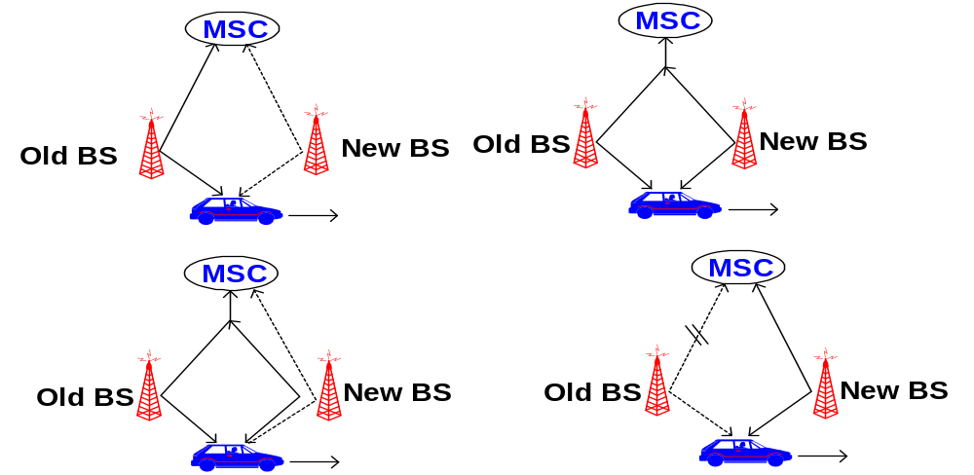
Personal Communication System (PCS)
Handoff
A process, which allows users to remain in touch, even while breaking the connection with one BS and establishing connection with another BS.

Slide 19
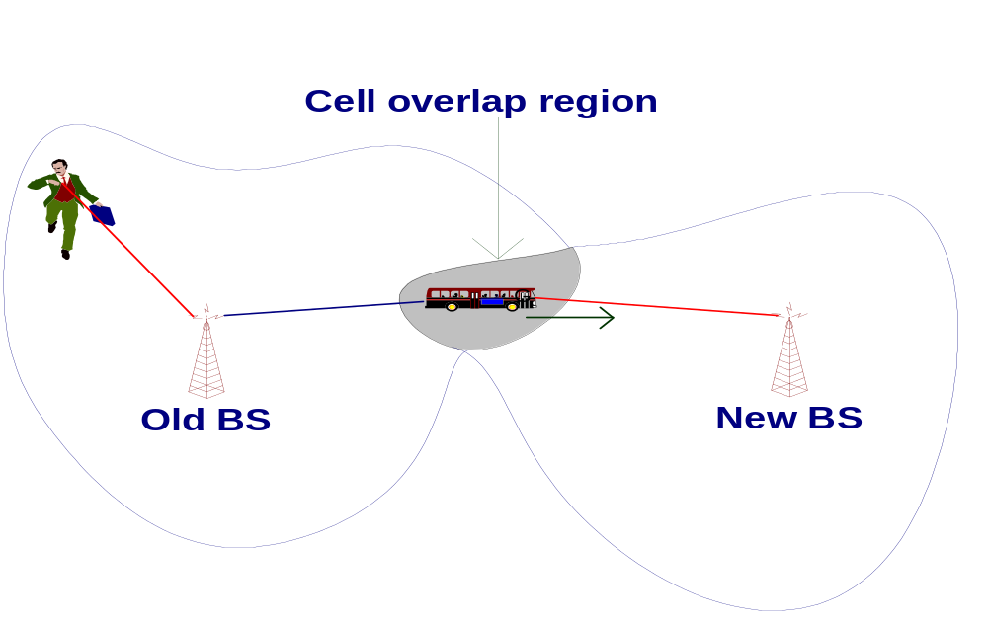
Personal Communication System (PCS)
Handoff
To keep the conversation going, the Handoff procedure should be completed while the MS (the bus) is in the overlap region.

Slide 20
Personal Communication System (PCS)
Handoff issues
  Handoff detection
  Channel assignment
  Radio link transfer

Slide 21
Personal Communication System (PCS)
Handoff detection strategies
Mobile-Controlled handoff (MCHO)
Network-Controlled handoff (NCHO)
Mobile-Assisted handoff (MAHO)

Slide 22
Personal Communication System (PCS)
Mobile-Controlled Handoff (MCHO)
In this strategy, the MS continuously monitors the radio signal strength and quality of the surrounding BSs. When predefined criteria are met, then the MS checks for the best candidate BS for an available traffic channel and requests the handoff to occur. MACHO is used in DECT and PACS.

Slide 23
Personal Communication System (PCS)
Network-Controlled Handoff (NCHO)
In this strategy, the surrounding BSs, the MSC or both monitor the radio signal. When the signal’s strength and quality deteriorate below a predefined threshold, the network arranges for a handoff to another channel. NCHO is used in CT-2 Plus and AMPS.

Slide 24
Personal Communication System (PCS)
Mobile-Assisted Handoff (MAHO)
It is a variant of NCHO strategy. In this strategy, the network directs the MS to measure the signal from the surrounding BSs and to report those measurements back to the network. The network then uses these measurements to determine where a handoff is required and to which channel. MACHO is used in GSM and IS-95 CDMA.

Slide 25
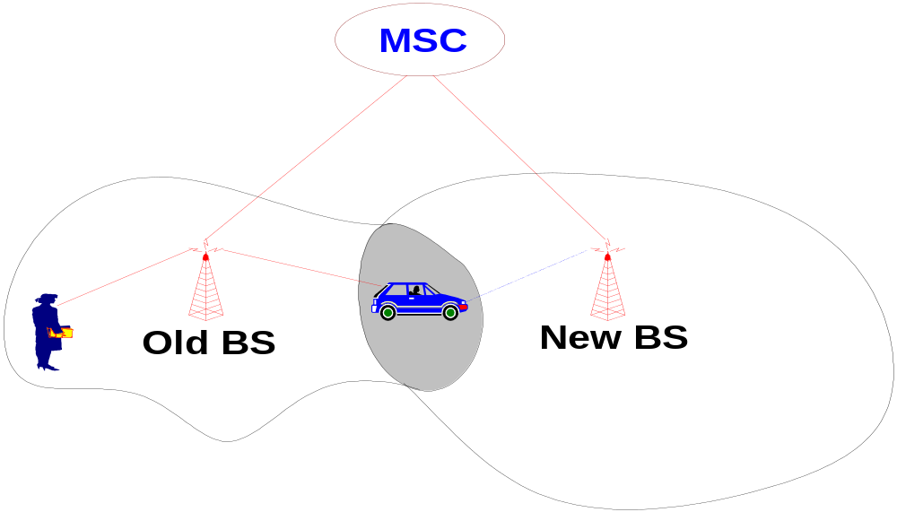
Personal Communication System (PCS)
Handoff types with reference to the network
Intra-system handoff or Inter-BS handoff
The new and the old BSs are connected to the same MSC.

Slide 26
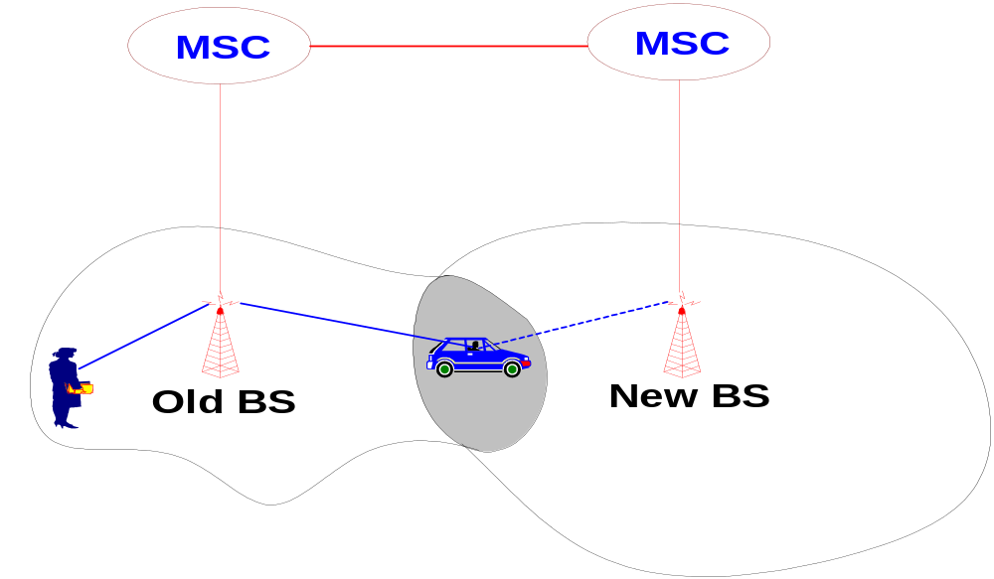
Personal Communication System (PCS)
Handoff types with reference to the network
Intersystem handoff or Inter-MSC handoff
The new and the old BSs are connected to different MSCs.

Slide 27
Personal Communication System (PCS)
Handoff types with reference to link transfer
Hard handoff
The MS connects with only one BS at a time, and there is usually some interruption in the conversation during the link transition.
Soft handoff
The two BSs are briefly simultaneously connected to the MU while crossing the cell boundary. As soon as the mobile's link with the new BS is acceptable, the initial BS disengages from the MU.

Slide 28
Personal Communication System (PCS)
Handoff types with reference to link transfer
Hard handoff
  MU temporarily suspends the voice conversation by sending a link suspend message to the old BS.
  MU sends a handoff request message through an idle time slot of the new BS to the network.
  The new BS sends a handoff ack message and marks the slot busy.
  The MU returns the old assigned channel by sending a link resume message to the old BS.

Slide 29
Personal Communication System (PCS)
Handoff types with reference to link transfer
Hard handoff
  MU continues voice communication while the network prepares for the handoff.
  Upon receipt of a handoff request message, the new BS sends a handoff ack message and reconfigures itself to effect the handoff.
  The MSC inserts a bridge into the conversation path and bridges the new BS.
  Finally, the network informs the MU to execute the handoff via both the new and old BSs by sending the handoff execute message.

Slide 30
Personal Communication System (PCS)
Handoff types with reference to link transfer
Hard handoff
  MU releases the old channel by sending an access release message to the old BS.
  Once the MU has made the transfer to the new BS, it sends the network a handoff complete message through the new channel, and resumes the voice communication. The network removes the bridge from the path and frees up the resources associated with the old channel.

Slide 31
Personal Communication System (PCS)
Handoff types with reference to link transfer
Soft handoff
  MU sends a pilot strength measurement message to the old BS, indicating the new BS to be added.
  The old BS sends a handoff request message to the MSC. If the MSC accepts the handoff request, it sends a handoff request message to the new BS.
  The BS sends a null traffic message to the MU to prepare the establishment of the communication link.

Slide 32
Personal Communication System (PCS)
Handoff types with reference to link transfer
Soft handoff
  The new BS sends a join request message to the MSC. The MSC bridges the connection for the two BSs, so that the handoff can be processed without breaking the connection.
  The new BS sends a handoff ack message to the old BS via the MSC. The old BS instructs the MU to add a link to the new BS by exchanging the handoff command and handoff complete messages.

Slide 33
Personal Communication System (PCS)
Handoff types with reference to link transfer
Soft handoff
  The old BS and the MSC conclude this procedure by exchanging the required handoff information. The quality of the new link is guaranteed by the exchange of the pilot measurement request and the pilot strength measurement message pair between the MU and the new BS.

Slide 34
Personal Communication System (PCS)
Roaming
Roaming is a facility, which allows a subscriber to enjoy uninterrupted communication from anywhere in the entire coverage space.
A mobile network coverage space may be managed by a number of different service providers. They must cooperate with each other to provide roaming facility.
Roaming can be provided only if some administrative and technical constraints are met.

Slide 35
Personal Communication System (PCS)
Roaming
Administrative constraints
  Billing.
  Subscription agreement.
  Call transfer charges.
  User profile and database sharing.
  Any other policy constraints.

Slide 36
Personal Communication System (PCS)
Roaming
Technical constraints
  Bandwidth mismatch. For example, European 900MHz band may not be available in other parts of the world. This may preclude some mobile equipment for roaming.
  Service providers must be able to communicate with each other. Needs some standard.
  Mobile station constraints.

Slide 37
Personal Communication System (PCS)
Roaming
Technical constraints
  Integration of a new service provider into the network. A roaming subscriber must be able to detect this new provider.
  Service providers must be able to communicate with each other. Needs some standard.
  Quick MU response to a service provider’s availability.
  Limited battery life.

Slide 38
Personal Communication System (PCS)
Location Management
Two-Tier Scheme
HLR: Home Location Register
A HLR stores user profile and the geographical location.
VLR: Visitor Location Register
A VLR stores user profile and the current location who is a visitor to a different cell that its home cell.

Slide 39
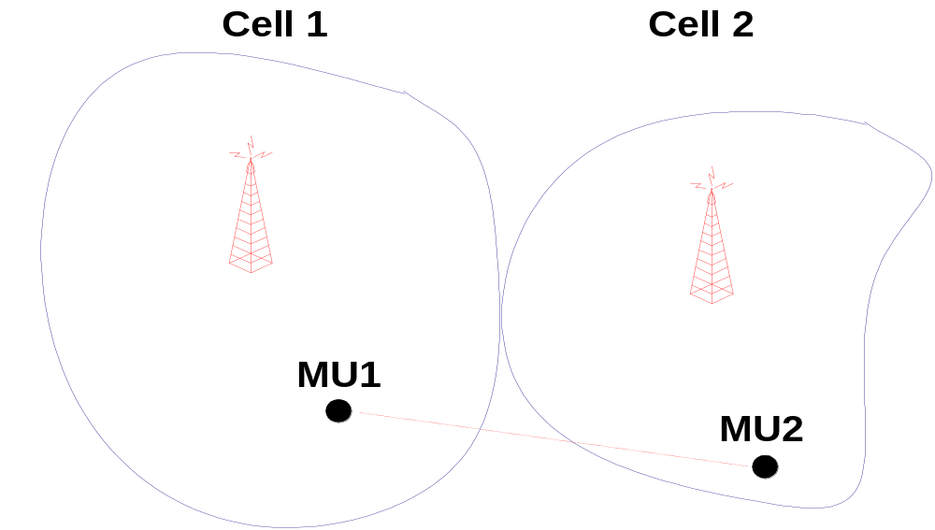
Personal Communication System (PCS)
Location Management
Two-Tier Scheme steps. MU1 wants to talk to MU2.

Slide 40
Personal Communication System (PCS)
Location Management
Two-Tier Scheme steps. MU1 wants to talk to MU2.
VLR of cell 2 is searched for MU2’s profile.
If it is not found, then HLR is searched.
Once the location of MU2 is found, then the information is sent to the base station of cell 1.
Cell 1 establishes the communication.

Slide 41
Personal Communication System (PCS)
Location Management
Two-Tier Scheme steps location update
MU2 moves from cell 1 to cell 2.
MU2’s location is changed so new location must be recorded.
HLR is updated with the new location address.
MU2’s entry is deleted from the VLR of cell 1 and new entry is made in cell 2’s VLR.

Slide 42
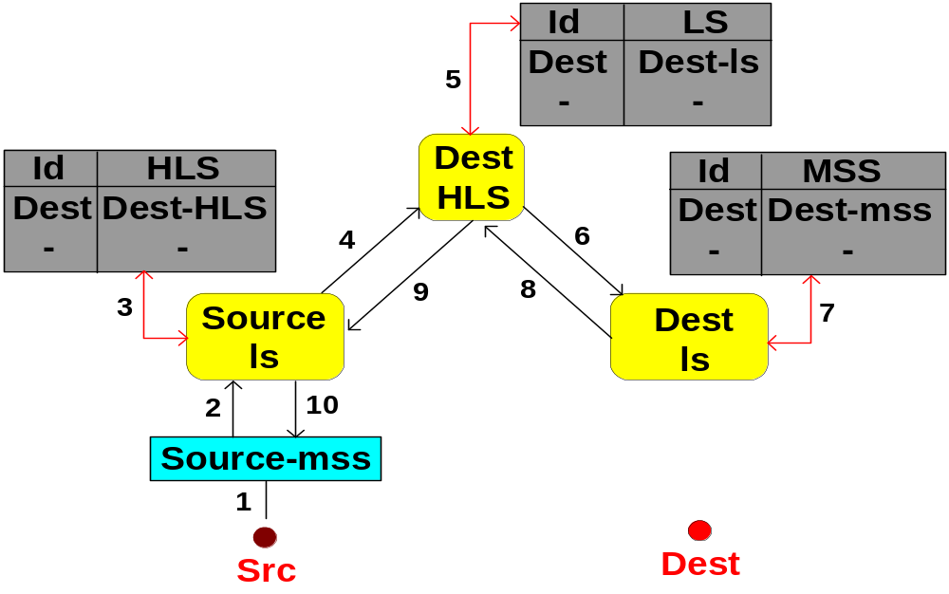
Personal Communication System (PCS)
Location Management
Two-Tier Scheme steps location search

Slide 43
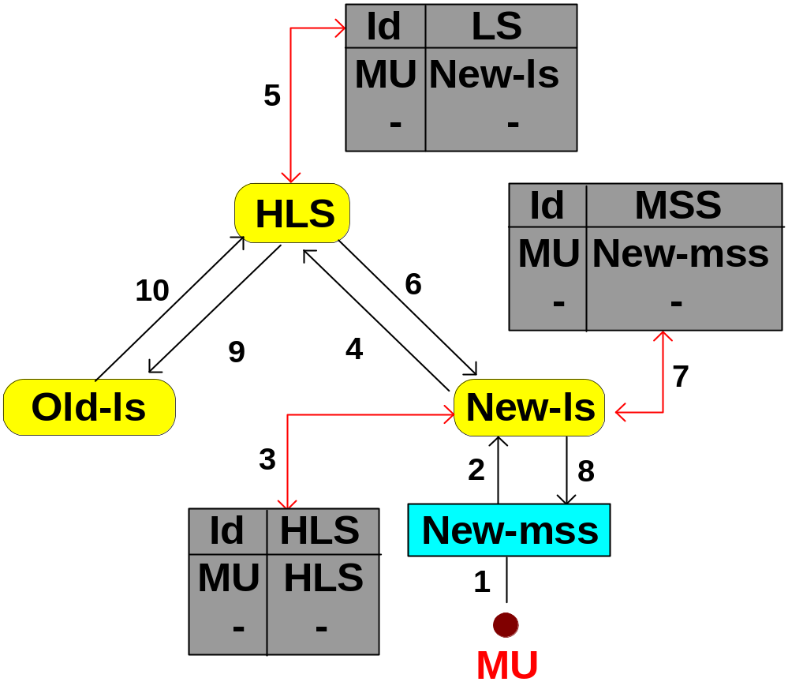
Personal Communication System (PCS)
Location Management
Two-Tier Scheme steps location update

Slide 44
Mobile Database Systems (MDS)
Part 2
Architecture
Data categorization
Data management
Transaction management
Recovery

Slide 45
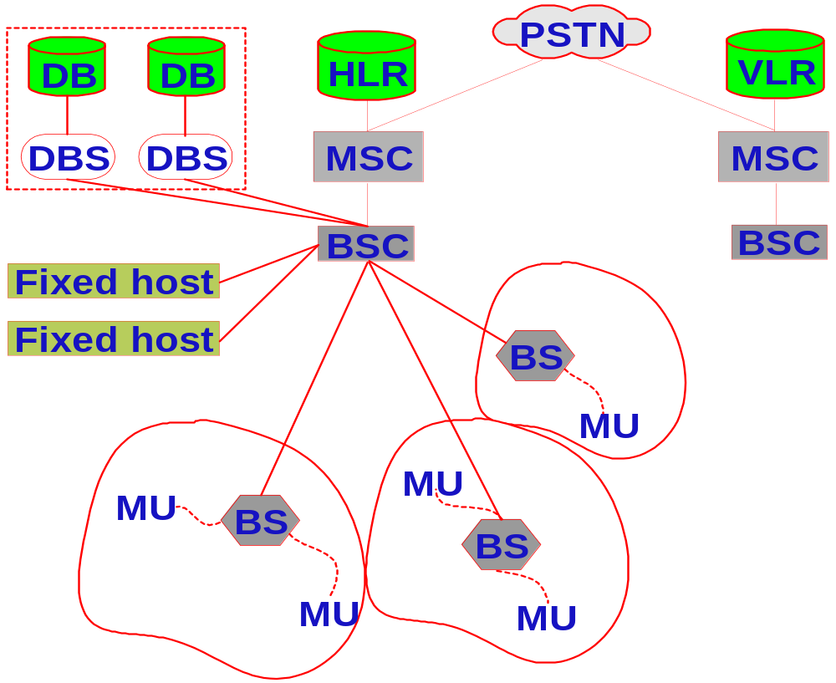
Mobile Database Systems (MDS)
A Reference Architecture (Client-Server model)

Slide 46
Mobile Database Systems (MDS)
MDS Applications
Insurance companies
Emergencies services (Police, medical, etc.)
Traffic control
Taxi dispatch
E-commerce
Etc.

Slide 47
Mobile Database Systems (MDS)
MDS Limitations
Limited wireless bandwidth
Wireless communication speed
Limited energy source (battery power)
Less secured
Vulnerable to physical activities
Hard to make theft proof.

Slide 48
Mobile Database Systems (MDS)
MDS capabilities
Can physically move around without affecting data availability
Can reach to the place data is stored
Can process special types of data efficiently
Not subjected to connection restrictions
Very high reachability
Highly portable

Slide 49
Mobile Database Systems (MDS)
Objective
To build a truly ubiquitous information processing system by overcoming the inherent limitations of wireless architecture.

Slide 50
Mobile Database Systems (MDS)
MDS Issues
Data Management
    Data Caching
    Data Broadcast (Broadcast disk)
    Data Classification
Transaction Management
    Query processing
    Transaction processing
    Concurrency control
    Database recovery

Slide 51
Mobile Database Systems (MDS)
MDS Data Management Issues
How to improve data availability to user queries using limited bandwidth?
Possible schemes
  Semantic data caching: The cache contents is decided by the results of earlier transactions or by semantic data set.
  Data Broadcast on wireless channels

Slide 52
Mobile Database Systems (MDS)
MDS Data Management Issues
How to improve data availability to user queries using limited bandwidth?
Semantic caching
  Client maintains a semantic description of the data in its cache instead of maintaining a list of pages or tuples.
  The server processes simple predicates on the database and the results are cached at the client.

Slide 53
Mobile Database Systems (MDS)
Mobile Database Systems (MDS)
MDS Data Management Issues
Data Broadcast (Broadcast disk)
A set of most frequently accessed data is made available by continuously broadcasting it on some fixed radio frequency. Mobile Units can tune to this frequency and download the desired data from the broadcast to their local cache.
A broadcast (file on the air) is similar to a disk file but located on the air.

Slide 54
Mobile Database Systems (MDS)
Mobile Database Systems (MDS)
MDS Data Management Issues
Data Broadcast (Broadcast disk)
The contents of the broadcast reflects the data demands of mobile units. This can be achieved through data access history, which can be fed to the data broadcasting system.
For efficient access the broadcast file use index or some other method.

Slide 55
Mobile Database Systems (MDS)
MDS Data Management Issues
How MDS looks at the database data?
Data classification
  Location Dependent Data (LDD)
  Location Independent Data (LID)

Slide 56
Mobile Database Systems (MDS)
MDS Data Management Issues
Location Dependent Data (LDD)
The class of data whose value is functionally dependent on location. Thus, the value of the location determines the correct value of the data.
Location Data value
Examples: City tax, City area, etc.

Slide 57
Mobile Database Systems (MDS)
MDS Data Management Issues
Location Independent Data (LID)
The class of data whose value is functionally independent of location. Thus, the value of the location does not determine the value of the data.
Example: Person name, account number, etc. The person name remains the same irrespective of place the person is residing at the time of enquiry.

Slide 58
Mobile Database Systems (MDS)
MDS Data Management Issues
Location Dependent Data (LDD)
Example: Hotel Taj has many branches in India. However, the room rent of this hotel will depend upon the place it is located. Any change in the room rate of one branch would not affect any other branch.
Schema: It remains the same only multiple correct values exists in the database.

Slide 59
Mobile Database Systems (MDS)
MDS Data Management Issues
Location Dependent Data (LDD)
LDD must be processed under the location constraints. Thus, the tax data of Pune can be processed correctly only under Pune’s finance rule.
Needs location binding or location mapping function.

Slide 60
Mobile Database Systems (MDS)
MDS Data Management Issues
Location Dependent Data (LDD)
Location binding or location mapping can be achieved through database schema or through a location mapping table.

Slide 61
Mobile Database Systems (MDS)
MDS Data Management Issues
Location Dependent Data (LDD) Distribution
MDS could be a federated or a multidatabase system. The database distribution (replication, partition, etc.) must take into consideration LDD.
One approach is to represent a city in terms of a number of mobile cells, which is referred to as “Data region”. Thus, Pune can be represented in terms of N cells and the LDD of Pune can be replicated at these individual cells.

Slide 62
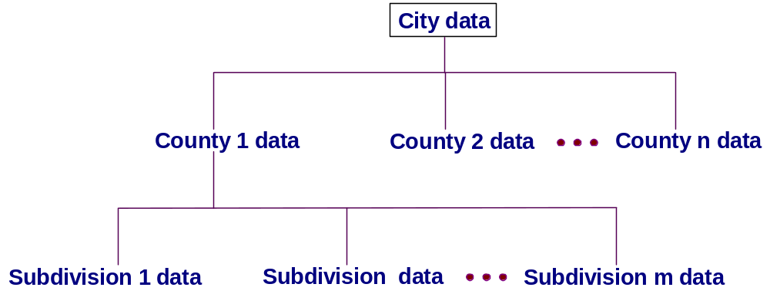
Mobile Database Systems (MDS)
MDS Data Management Issues
Concept Hierarchy in LDD
In a data region the entire LDD of that location can be represented in a hierarchical fashion.

Slide 63
Mobile Database Systems (MDS)
MDS Query processing
Query types
  Location dependent query
  Location aware query
  Location independent query

Slide 64
Mobile Database Systems (MDS)
MDS Query processing
  Location dependent query
  A query whose result depends on the geographical location of the origin of the query.
  Example
  What is the distance of Pune railway station from here?
  The result of this query is correct only for “here”.

Slide 65
Mobile Database Systems (MDS)
MDS Query processing
  Location dependent query
  Situation: Person traveling in the car desires to know his progress and continuously asks the same question. However, every time the answer is different but correct.
  Requirements: Continuous monitoring of the longitude and latitude of the origin of the query. GPS can do this.

Slide 66
Mobile Database Systems (MDS)
MDS Transaction Management
  Transaction properties: ACID (Atomicity, Consistency, Isolation, and Durability).
  Too rigid for MDS. Flexibility can be introduced using workflow concept. Thus, a part of the transaction can be executed and committed independent to its other parts.

Slide 67
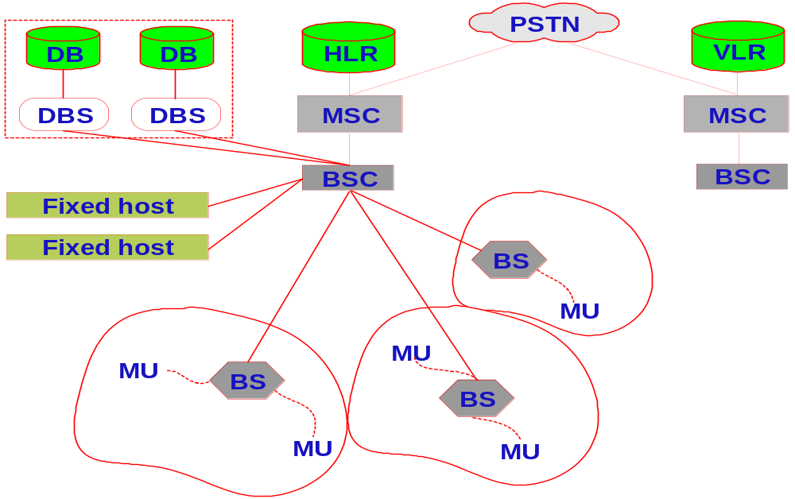
Mobile Database Systems (MDS)
MDS Transaction Management
  Transaction fragments for distribution.

Slide 68
Mobile Database Systems (MDS)
MDS Transaction Management
  Transaction fragments for distributed execution
Execution scenario: User issues transactions from his/her MU and the final results comes back to the same MU. The user transaction may not be completely executed at the MU so it is fragmented and distributed among database servers for execution. This creates a Distributed mobile execution.

Slide 69
Mobile Database Systems (MDS)
MDS Transaction Management
  A mobile transaction (MT) can be defined as
    T_{i} is a triple <F, L, FLM>; where
    F = {e₁, e₂, …, e_{n}} is a set of execution fragments,
    L = {l₁, l₂, …, l_{n}} is a set of locations, and
    FLM = {flm₁, flm₂, …, flm_{n}} is a set of fragment location mapping where ∀j, flm_{i} (e_{i}) = l_{i}

Slide 70
Mobile Database Systems (MDS)
MDS Transaction Management
An execution fragment e_{ij} is a partial order e_{ij} = {σ_{j}, ≤_{j}} where
  σ_{i} = OS_{j} ∪ {N_{i}} where OS_{j} = ∪_{k}O_{jk}, O_{jk}∈ {read, write},
    and N_{j} {Abort_{L}, Commit_{L}}.
  For any O_{jk} and O_{jl} where O_{jk} = R(x) and O_{jl} = W(x) for data object x, then either O_{jk} ≤_{j} O_{jl} or O_{jl} ≤_{j} O_{jk}.

Slide 71
Mobile Database Systems (MDS)
MDS Transaction Management
Mobile Transaction Models
Kangaroo Transaction: It is requested at a MU but processed at DBMS on the fixed network. The management of the transaction moves with MU. Each transaction is divided into subtransactions. Two types of processing modes are allowed, one ensuring overall atomicity by requiring compensating transactions at the subtransaction level.

Slide 72
Mobile Database Systems (MDS)
MDS Transaction Management
Mobile Transaction Models
Reporting and Co-Transactions: The parent transaction (workflow) is represented in terms of reporting and co-transactions which can execute anywhere. A reporting transaction can share its partial results with the parent transaction anytime and can commit independently. A co-transaction is a special class of reporting transaction, which can be forced to wait by other transaction.

Slide 73
Mobile Database Systems (MDS)
MDS Transaction Management
Mobile Transaction Models
Clustering: A mobile transaction is decomposed into a set of weak and strict transactions. The decomposition is done based on the consistency requirement. The read and write operations are also classified as weak and strict.

Slide 74
Mobile Database Systems (MDS)
MDS Transaction Management
Mobile Transaction Models
Semantics Based: The model assumes a mobile transaction to be a long lived task and splits large and complex objects into smaller manageable fragments. These fragments are put together again by the merge operation at the server. If the fragments can be recombined in any order then the objects are termed reorderable objects.

Slide 75
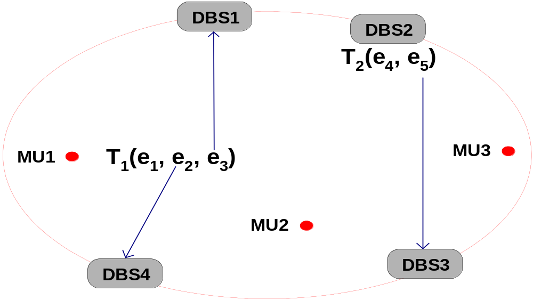
Mobile Database Systems (MDS)
MDS Transaction Management
Mobile Transaction execution.

Slide 76
Mobile Database Systems (MDS)
MDS Transaction Management
  Serialization of concurrent execution.
  Two-phase locking based (commonly used)
  Timestamping
  Optimistic
Reasons these methods may not work satisfactorily
  Wired and wireless message overhead.
  Hard to efficiently support disconnected operations.
  Hard to manage locking and unlocking operations.

Slide 77
Mobile Database Systems (MDS)
MDS Transaction Management
  Serialization of concurrent execution.
New schemes based on timeout, multiversion, etc., may work. A scheme, which uses minimum number of messages, especially wireless messages is required.

Slide 78
Mobile Database Systems (MDS)
MDS Transaction Management
Database update to maintain global consistency.
Database update problem arises when mobile units are also allowed to modify the database. To maintain global consistency an efficient database update scheme is necessary.

Slide 79
Mobile Database Systems (MDS)
MDS Transaction Management
  Transaction commit.
  In MDS a transaction may be fragmented and may run at more than one nodes (MU and DBSs). An efficient commit protocol is necessary. 2-phase commit (2PC) or 3-phase commit (3PC) is no good because of their generous messaging requirement. A scheme which uses very few messages, especially wireless, is desirable.

Slide 80
Mobile Database Systems (MDS)
MDS Transaction Management
  Transaction commit.
  One possible scheme is “timeout” based protocol.
  Concept: MU and DBSs guarantee to complete the execution of their fragments of a mobile transaction within their predefined timeouts. Thus, during processing no communication is required. At the end of timeout, each node commit their fragment independently.

Slide 81
Mobile Database Systems (MDS)
MDS Transaction Management
  Transaction commit.
  Protocol: TCOT-Transaction Commit On Timeout
  Requirements
  Coordinator: Coordinates transaction commit
  Home MU: Mobile Transaction (MT) originates here
  Commit set: Nodes that process MT (MU + DBSs)
  Timeout: Time period for executing a fragment

Slide 82
Mobile Database Systems (MDS)
MDS Transaction Management
  Protocol: TCOT-Transaction Commit On Timeout
  MT arrives at Home MU.
  MU extract its fragment, estimates timeout, and send rest of MT to the coordinator.
  Coordinator further fragments the MT and distributes them to members of commit set.
  MU processes and commits its fragment and sends the updates to the coordinator for DBS.
  DBSs process their fragments and inform the coordinator.
  Coordinators commits or aborts MT.

Slide 83
Mobile Database Systems (MDS)
MDS Transaction Management
  Transaction and database recovery.
Complex for the following reasons
  Some of the processing nodes are mobile
  Less resilient to physical use/abuse
  Limited wireless channels
  Limited power supply
  Disconnected processing capability

Slide 84
Mobile Database Systems (MDS)
MDS Transaction Management
  Transaction and database recovery.
Desirable recovery features
  Independent recovery capability
  Efficient logging and checkpointing facility
  Log duplication facility

Slide 85
Mobile Database Systems (MDS)
MDS Transaction Management
  Transaction and database recovery.
Independent recovery capability reduces communication overhead. Thus, MUs can recover without any help from DBS
Efficient logging and checkpointing facility conserve battery power
Log duplication facility improves reliability of recovery scheme

Slide 86
Mobile Database Systems (MDS)
MDS Transaction Management
  Transaction and database recovery.
Possible approaches
Partial recovery capability
Use of mobile agent technology

Slide 87
Mobile Database Systems (MDS)
MDS Transaction Management
  Transaction and database recovery.
Possible MU logging approaches
Logging at the processing node (e.g., MU)
Logging at a centralized location (e.g., at a designated DBS)
Logging at the place of registration (e.g., BS)
Saving log on Zip drive or floppies.

Slide 88
Mobile Database Systems (MDS)
Mobile Agent Technology
A mobile agent is an independent software module capable of
  Migrating to any node on the network
  Capable of spawning and eliminating itself
  Capable of recording its own history

Slide 89
Mobile Database Systems (MDS)
Mobile Agent Technology
A mobile agent can be used for the following activities, which are essential for recovery.
  Centralized and distributed logging
  Log carrier. A Mobile unit may need to carry its log with it for independent recovery
  Log processing for database recovery
  Transaction commit or abort

Slide 90
Mobile Database Systems (MDS)
Mobile Agent Technology
Possible approaches
  Agent broadcast on a dedicated wireless channel
  Pool of agents at every processing node
  Agent migration to a required node.

Slide 91
Mobile Database Systems (MDS)
Conclusions and summary
Wireless network is becoming a commonly used communication platform. It provides a cheaper way to get connected and in some cases this is the only way to reach people. However, it has a number of easy and difficult problems and they must be solved before MDS can be built. This tutorial discussed some of these problems and identified a number of possible approaches.

Slide 92
Mobile Database Systems (MDS)
Conclusions and summary
The emerging trend is to make all service providing disciplines, such as web, E-commerce, workflow systems, etc., fully mobile so that any service can be provided from any place. Customer can surf the information space from any location at any time and do their shopping, make flight reservation, open bank account, attend lectures, and so on. This is what the wireless technology driving us to.

Slide 93
Mobile Database Systems (MDS)
References
Acharya, S., Alonso, R., Franklin, M., and Zdonik, S. Broadcast Disks: Data management for Asymmetric Communication Environments. Proc. ACM SIGMOD Conf., San Jose, May, 1995.
Alonso, R., and Korth, H. Database Systems Issues in Nomadic Computing. Proc. ACM SIGMOD International Conf. on management of Data, May 1993.

Slide 94
Mobile Database Systems (MDS)
References
Barbara, D., and Imielinski, T. Sleepers and Workaholics: Caching Strategies in Mobile Environments. Proc. ACM SIGMOD Conf., Minneapolis, May, 1994.
Chrysanthis, P. K., Transaction Processing in Mobile Computing Environment, in IEEE Workshop on Advances in Parallel and Distributed Systems, October 1993.

Slide 95
Mobile Database Systems (MDS)
References
Dhawan, C. Mobile Computing. McGraw-Hill, 1997.
Dunham, M. H., Helal, A., and Balakrishnan, S., A Mobile Transaction Model That Captures Both the Data and Movement Behavior, ACM/Baltzer Journal on Special Topics in Mobile Networks and Applications, 1997.
Forman, H. George and Zahorjan, J. The Challenges of Mobile Computing, IEEE Computers, Vol. 27, No. 4, April 1994.

Slide 96
Mobile Database Systems (MDS)
References
Pitoura, E. and Bhargava, B., Maintaining Consistency of Data in Mobile Distributed Environments. Proceedings of 15th International Conference on Distributed Computing Systems., 1995.
Pitoura, E. and Bhargava, B., Building Information Systems for Mobile Environments, Proc. 3rd. Int. conf. on Information and Knowledge Management, Washington, DC, No. 1994.

Slide 97
Mobile Database Systems (MDS)
References
Vijay Kumar, “Timeout-based Mobile Transaction Commit Protocol”, 2000 ADBIS-DASFAA Symposium on Advances in Databases and Information Systems, Prague, Sep. 5-8, 2000.
Shaul Dar, Michael Franklin, Bjorn T. Johnsson, Divesh Srivastava, and Michael Tan, “Semantic Data Caching and Replacement”, Proc. Of the 22nd VLDB Conference, Mumbai, India, 1996.

Slide 98
Mobile Database Systems (MDS)
References
E. Pitoura and G. Samaras, “Data Management for Mobile Computing”, Kluwer Academic Publishers, 1998.

